Slide 1
Kepler Exoplanet search
Team: VinculuM

Slide 2


Aaliyah
Nikola

Slide 3

On the verge of finding a new home

Slide 4

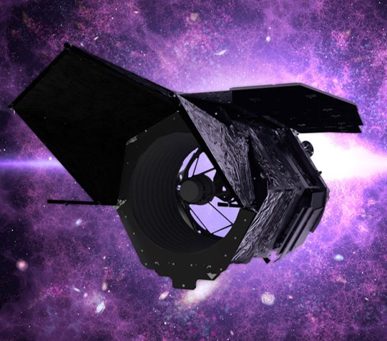
Overview
Kepler is a satellite build by NASA
The mission is to find exoplanets and potentially a habitual planet
Kepler has made over 10,000 observations

Slide 5


